Slide 1
Employee Data Analysis using Excel
STUDENT NAME: Nivetha.V
REGISTER NO: 312205925
NM ID:0AF14AC6A06974DBC1A49480ECF03551.
DEPARTMENT: B.COM(GENERAL)
COLLEGE : VIDHYA SAGAR WOMEN'S COLLEGE,
CHENGALPATTU-603111

Slide 2
PROJECT TITLE
Employee Performance Analysis using Excel

Slide 3


AGENDA
Problem Statement
Project Overview
End Users
Our Solution and Proposition
Dataset Description
Modelling Approach
Results and Discussion
Conclusion
3/21/2024 Annual Review

Slide 4

PROBLEM STATEMENT
Employment performance analysis evaluates employee productivity and efficiency, helping organizations improve workforce effectiveness and achieve business goals.

Slide 5

PROJECT OVERVIEW
Employee data analysis involves collecting and analyzing data on aspects like employee performance, turnover rates, engagement levels, and skill gaps.
It uses statistical methods, data visualization, and predictive analytics to identify trends and patterns.

Slide 6


WHO ARE THE END USERS?
✓Board of Directors ✓Chief Executive Officer (CEO) ✓Chief Officers (CFO, COO, CMO, etc.) ✓Vice Presidents/Directors ✓Department Managers ✓Supervisors/Team Leaders ✓Operational Staff ✓Frontline Workers

Slide 7

OUR SOLUTION AND ITS VALUE PROPOSITION
Conditional formatting: To analyze employee performance by visually highlighting data.
Filter: The Filter function to display specific data (e.g., high performers or low sales).
Formulas:In Excel, use formulas like =AVERAGE(), =SUM(), =IF(), and =RANK() to calculate metrics such as average performance, total sales, and rankings,..
Pivot summary:They enable you to filter, group, and compare performance metrics dynamically, making it easy to spot trends.

Slide 8

Dataset Description
* Employee dataset: Download from kaggle
*There are 26 features
*The dataset used 9 features.
* The employment performance analysis dataset contains the following information:
✓Employee data
✓Employe id number
✓ Name-Text
✓Employment type
✓Performance metrics
✓Gender -male/female
✓ Employment rating number.

Slide 9

THE "WOW" IN OUR SOLUTION
1. Automated Data Visualization
2. Predictive Analytics
3. Personalized Employee Profiles
4. Real-time Performance Tracking
5. Data-Driven Decision Support
6. Scalable and Customizable
7. Intuitive User Experience
3/21/2024 Annual Review
9

Slide 10

MODELLING
DATA COLLECTION:
•Download employee data set from edunet dashboard.
FEATURES COLLECTION:
•conditional formatting
•Filter and sorts
•pivot table etc..
DATA CLEANING:
•Identifying the missing data.
•Filtering the missing data
10

Slide 11
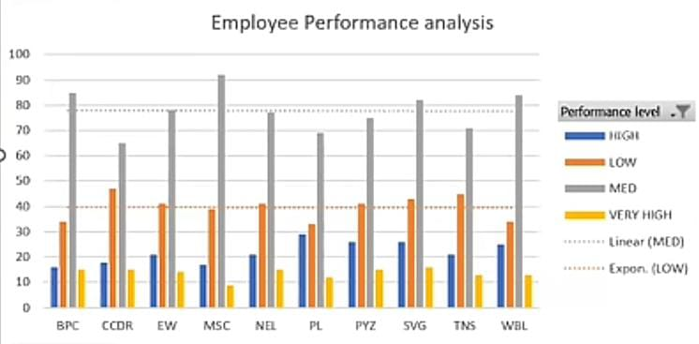
RESULTS
The result of using Excel for employee performance analysis is a clear, data-driven view of employee metrics that helps identify top performers, areas needing improvement, and overall trends.
11

Slide 12
conclusion
Excel is a powerful tool for employee performance analysis, offering various features like formulas, Pivot Tables, charts, and conditional formatting that enable detailed, visual insights into performance data.

